Slide 1
A Markov Chains Example
A STOCK EXAMPLE
Presenter:
Supervisor:
Mehrin Farzana
ID. 2101013
Dept. of Ire
BDU
2021-22
Date: 05/05/2024
Md. Mehedi Hasan
Lecturer(Mathematics)
Department of General Education
BDU

Slide 2
01
Example Statement
contents
02
Transition Matrix
03
Understanding Transition Matrix
04
State Transition Diagram

Slide 3
01
EXAMPLE STATEMENT
A Stock Example
Suppose now that the stock market model is changed so that the stock’s going up tomorrow depends upon whether it increased today and yesterday. In particular, if the stock has increased for the past two days, it will increase tomorrow with probability 0.9. If the stock increased today but decreased yesterday, then it will increase tomorrow with probability 0.6. If the stock decreased today but increased yesterday, then it will increase tomorrow with probability 0.5. Finally, if the stock decreased for the past two days, then it will increase tomorrow with probability 0.3

Slide 4
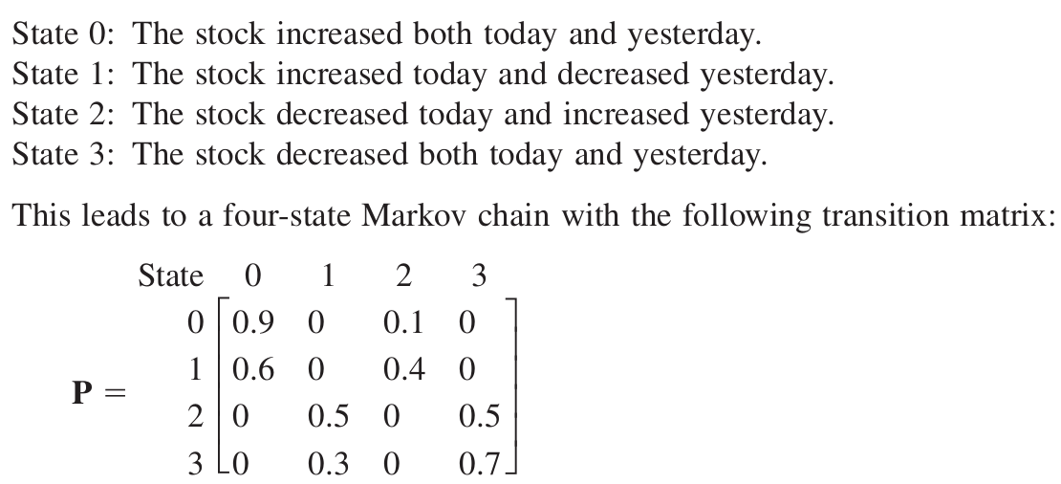
02
TRANSITION MATRIX

Slide 5
03
UNDERSTANDING TRANSITION MATRIX
‘P’ denoting probability;
P(increase tomorrow | increased yesterday & today) = 0.9
P(increase tomorrow | decreased yesterday & increased today) = 0.6
P(increase tomorrow | increased yesterday & decreased today) = 0.5
P(increase tomorrow | decreased yesterday & today) = 0.3
so,
P(decrease tomorrow | increased yesterday & today) = 1 - 0.9 = 0.1
P(decrease tomorrow | decreased yesterday & increased today) = 1 - 0.6 = 0.4
P(decrease tomorrow | increased yesterday & decreased today) = 1 - 0.5 = 0.5
P(decrease tomorrow | decreased yesterday & today) = 1 - 0.3 = 0.7

Slide 6
03
UNDERSTANDING TRANSITION MATRIX _{[continued]}
and,
P(increase the next day & decrease the day before | increased yesterday & today) = 0
P(increase the next day & decrease the day before | decreased yesterday & increased today) = 0
P(increase the next day & the day before | increased yesterday & decreased today) = 0
P(increase tomorrow & the day before | decreased yesterday & today) = 0
P(decrease tomorrow & the day before | increased yesterday & today) = 0
P(decrease tomorrow & the day before | decreased yesterday & increased today) = 0
P(decrease tomorrow & increase the day before | increased yesterday & decreased today) = 0
P(decrease tomorrow & increase the day before | decreased yesterday & today) = 0
[NB. tomorrow = “the next day” & today = “the day before (next day)”]

Slide 7
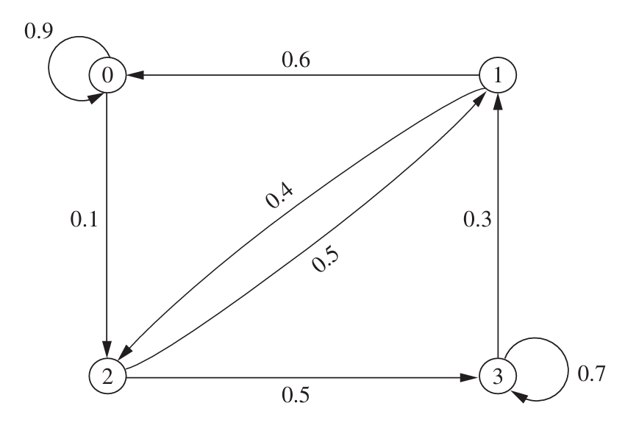
04
STATE TRANSITION DIAGRAM
Figure 1: State transition diagram

Slide 8
THANK YOU!

